Slide 1

Design Review
Austin Keener
Joseph Spall
Joshua Oldenburg
Juan Elizondo-Villasis
Varun Madabushi

Slide 2
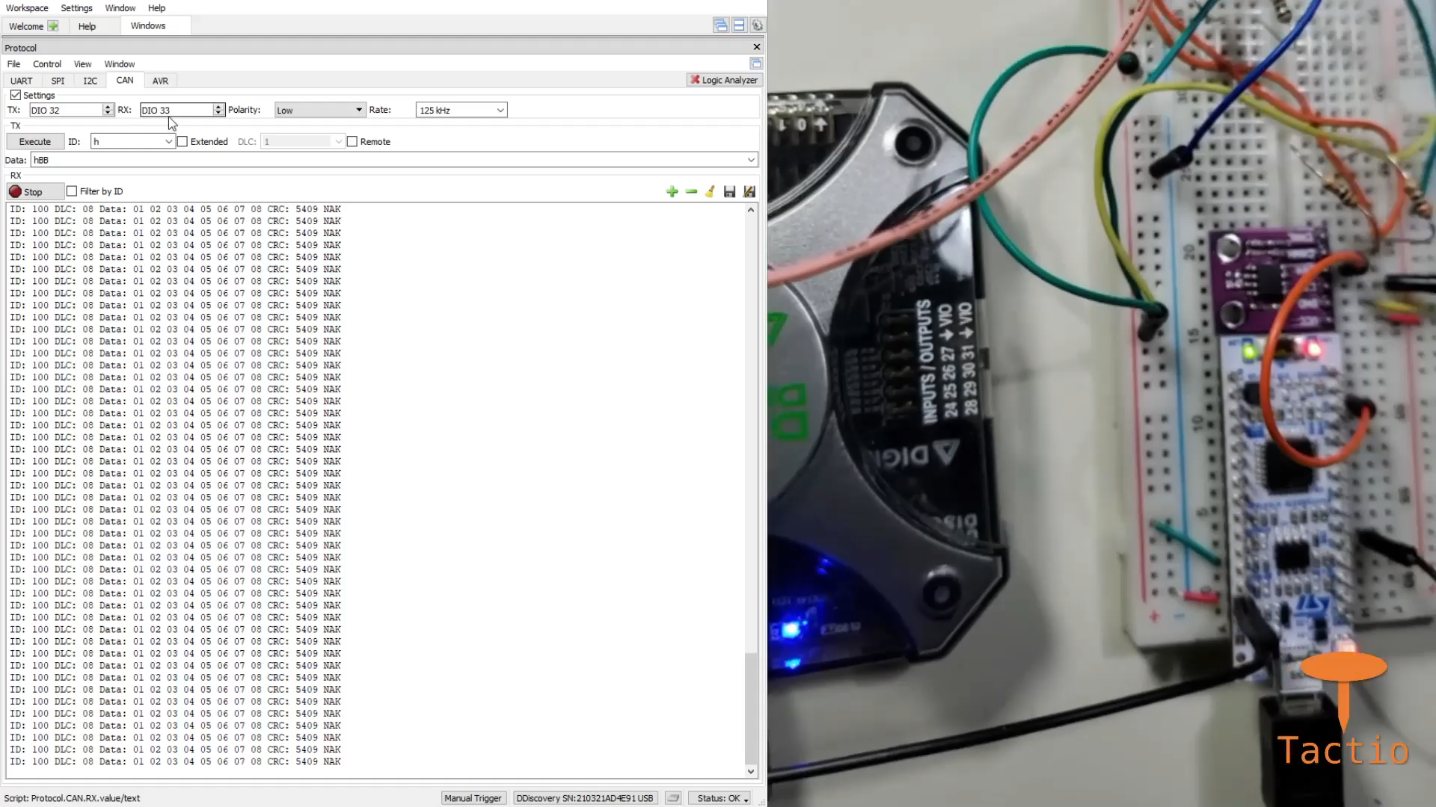
Firmware Status

Slide 3
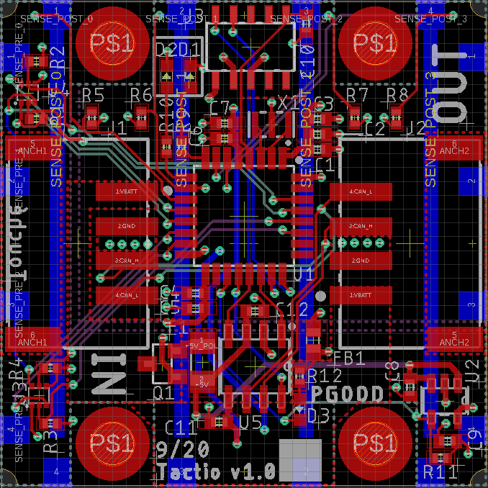
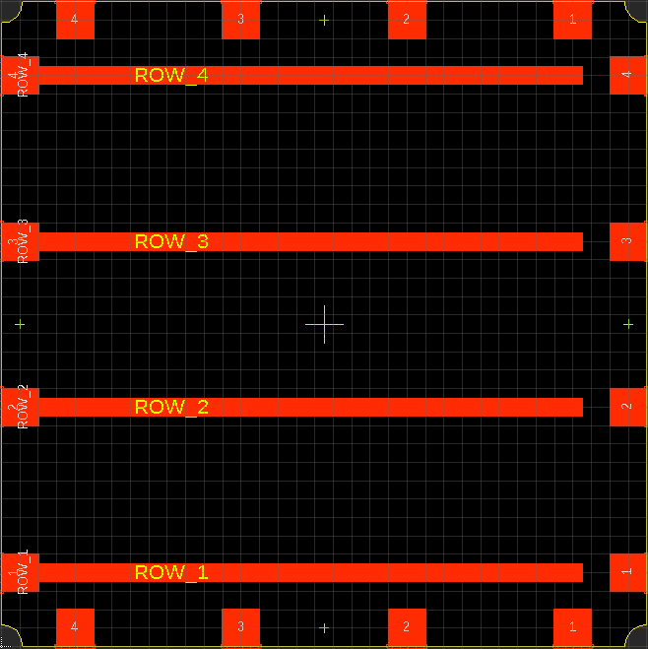
Electrical Status
Boards were internally design reviewed
Ordered most electrical elements
Rigid PCB from JLCPCB
Flex PCB from PCBWay
Components from Digi-Key
Received everything this week

Slide 4
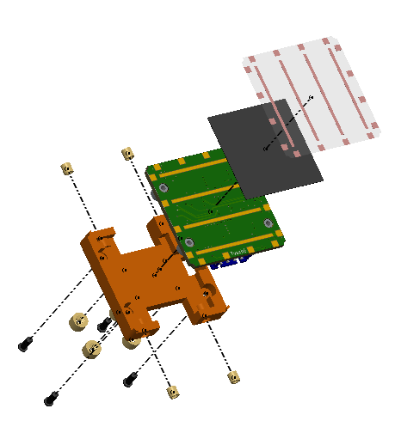
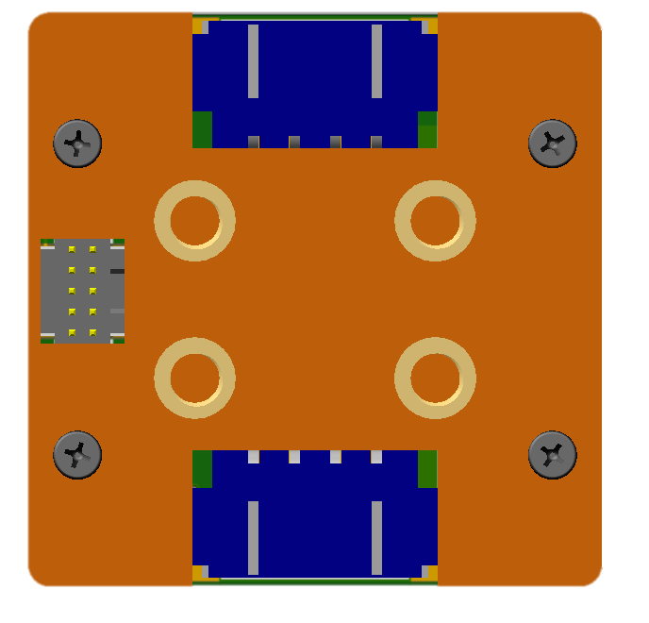
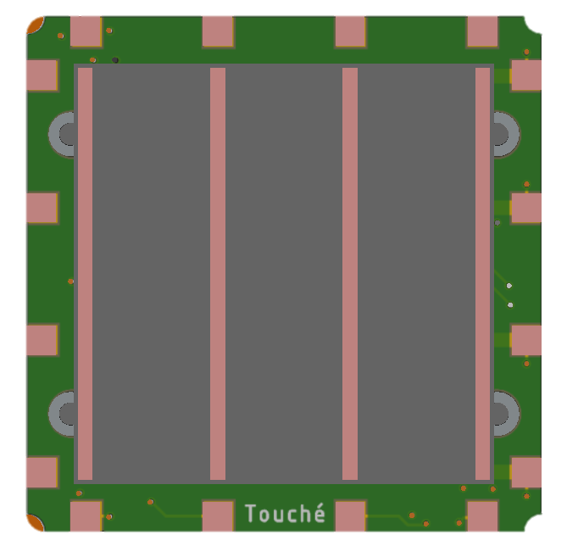
Mechanical Status
Node mechanical design is complete
Utilize threaded inserts for flexible mounting configurations
Started test 3D print

Slide 5
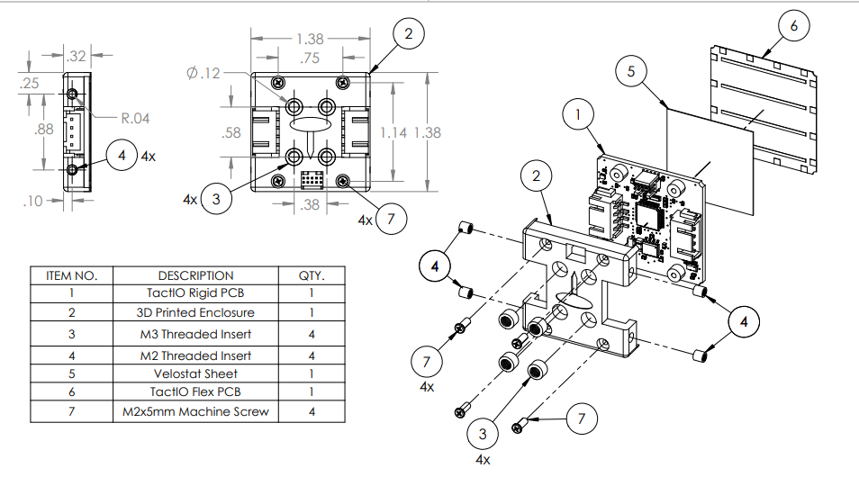
Mechanical Design

Slide 6
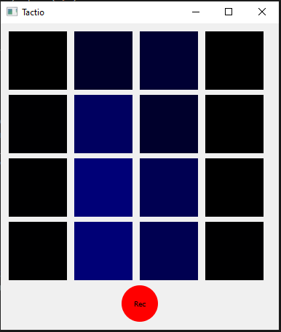
Software Status
Microcontroller sends PC sensor ID and values
Extendable to multiple devices
Can organize multiple sensors for viewing
Can record and save sensor values for later processing
Stored in JSON format

Slide 7
Bill of Materials
Ordered:
36 flexible PCBs
30 rigid PCBs
Enough components for 20 sensors
Final cost of production per sensor at our prototype volume:
$35.79
Component | Cost per Sensor
Flexible PCB | $3.02
STM32 MCU | $2.66
Rigid PCB | $1.88
Table 1. Highest cost components

Slide 8
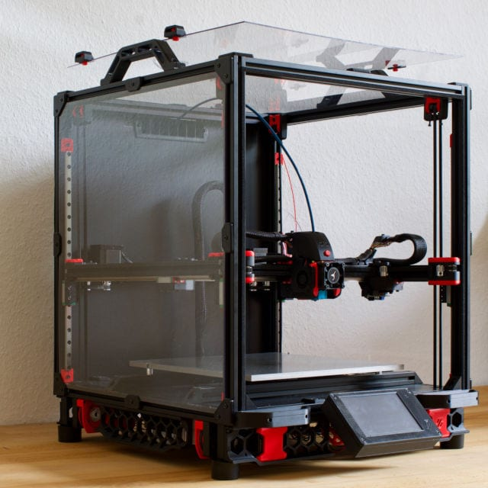
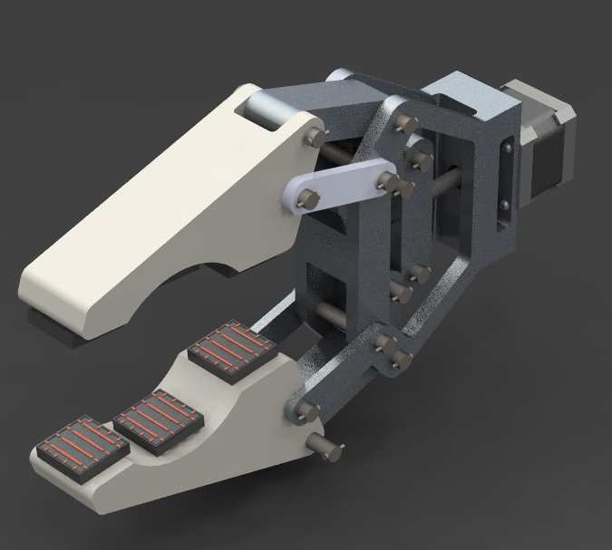
Next Steps: MECHANICAL
Check fit with PCB to verify tolerances
Mass production of enclosures
Node assembly
Design and make demo platform

Slide 9
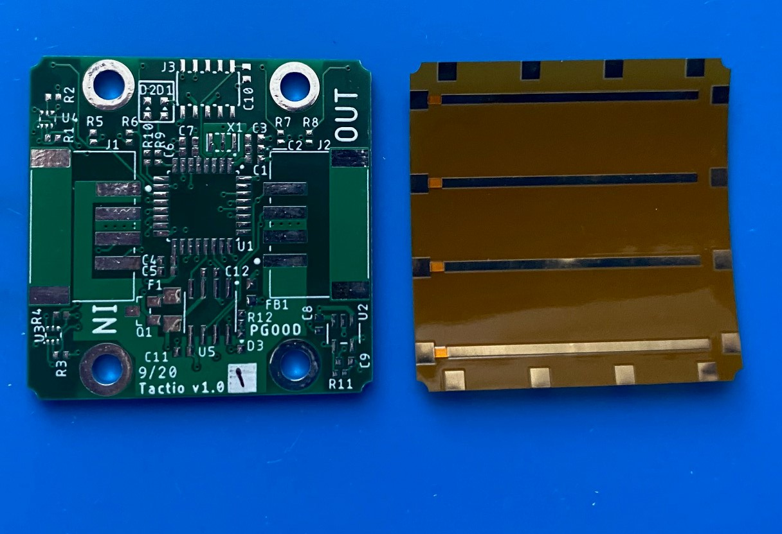
Next Steps: Electrical
Subsystem assembly and testing in this order:
Power system
Grid sensing system
Communication system
Full system assembly of all sensing boards to allow testing of firmware and software

Slide 10
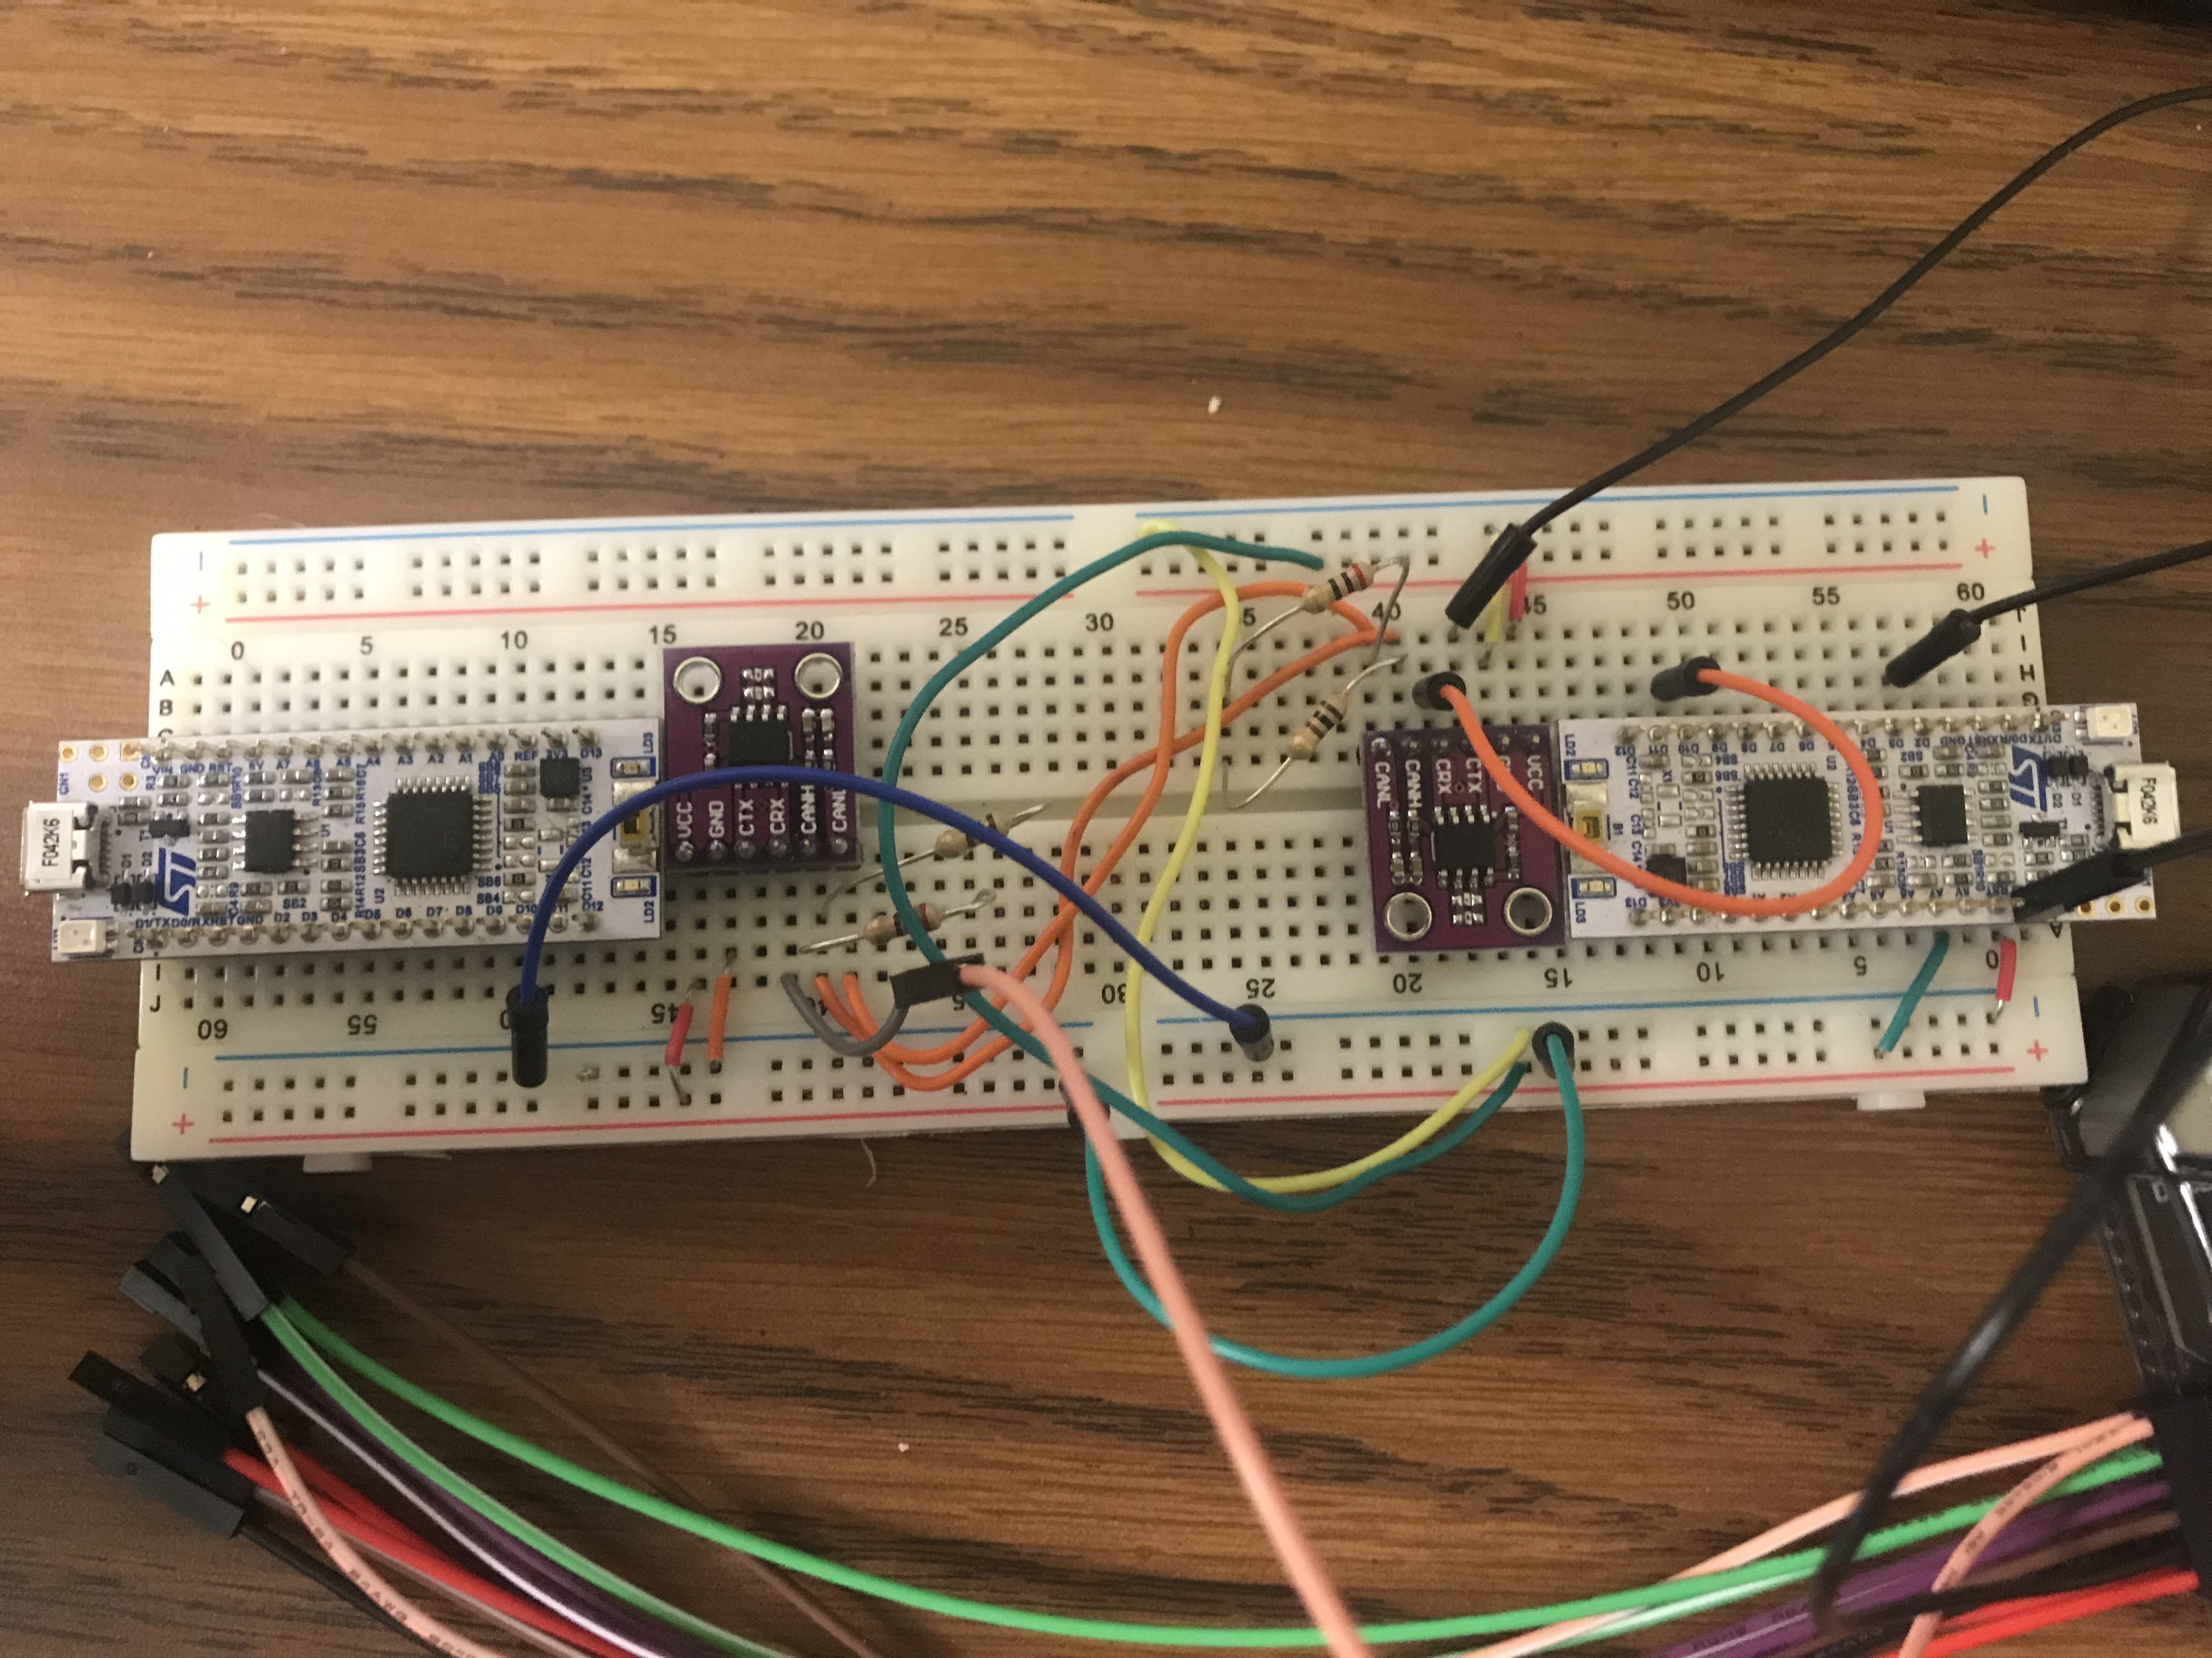
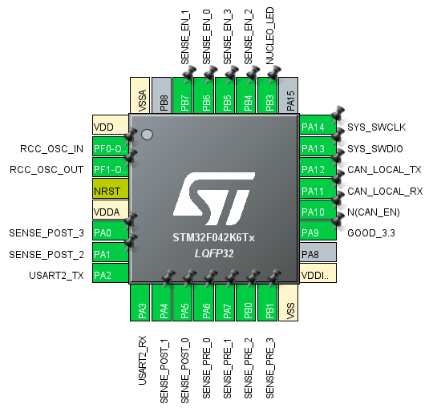
Next Steps: Firmware
Test firmware on real devices
Design and implement calibration
Implement DSP algorithms (if needed)
Finalize Mbed network controller firmware

Slide 11
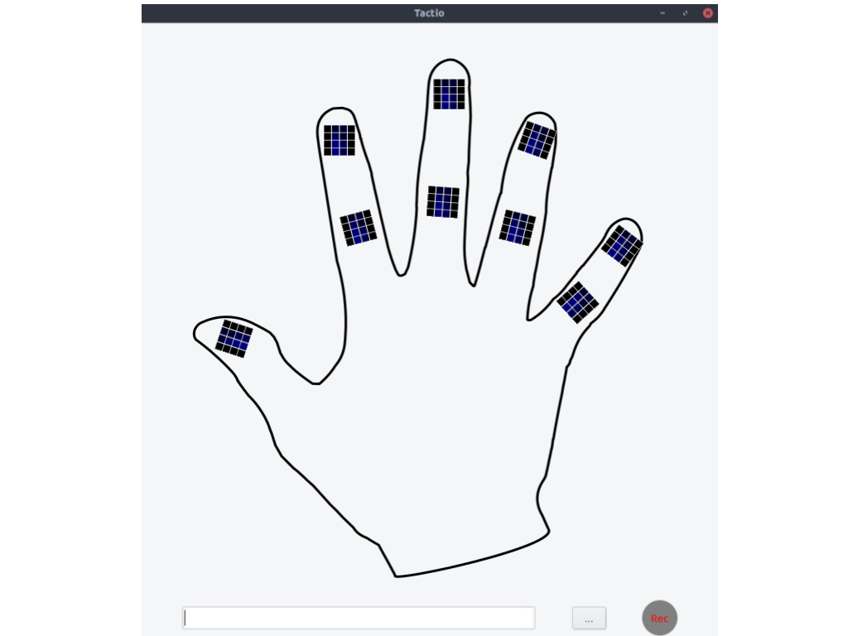

Next Steps: Software
Test desktop software with functional hardware
Utilize protobuf for serialization of objects
Run multiple sensors on a bus

Slide 12
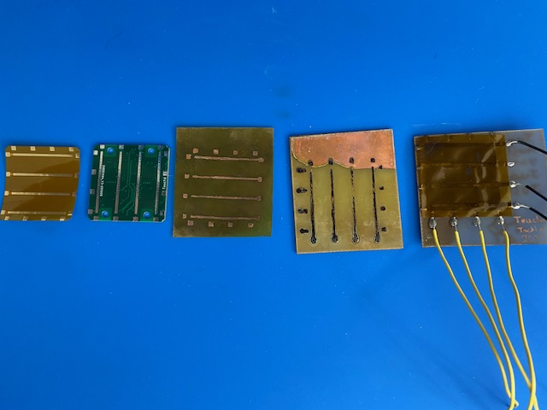
Open Questions: Accuracy
Activations on the prototype sensor did not correlate exactly with the location of force applied
Solutions:
Improved manufacturing and assembly
Data recording software
Calibration
Real-time DSP development

Slide 13
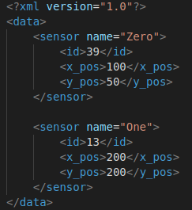
Open Questions: Visualization
Sensor hardware supports multiple configurations
Visualization software must reflect this
User-defined XML file to define preferred visualization

Slide 14
Questions?

